Slide 1

Simulation and Detection of Sybil Attacks in Vehicular Ad Hoc Networks using OMNeT++, Veins and SUMO
21ECC402P-Computer Communication and Network Security
Team Members:
Aravindh J - (RA2311004010592)
B .Sri Vignesh - (RA2311004010587)
Vigneshwaran B - (RA2311004010552)
Guide: Dr.E.Elamaran
Department of Electronics and Communication Engineering
Srm Institute of Science and Technology

Slide 2
Agenda
Introduction to VANET and Sybil attacks
Project objectives
Problem statement
Literature survey
System architecture
Proposed methodology
Tools and technologies used
Existing Sybil attack detection
Methods Proposed detection
Method Realistic
constraints and limitations
Conclusion
Future scope

Slide 3
Introduction
Vehicular Ad Hoc Networks are communication networks in which vehicles exchange information with nearby vehicles and roadside infrastructure without relying entirely on fixed communication infrastructure. Vehicles continuously share information such as their identity, position, speed, direction and timestamp to support intelligent transportation and safety applications. The highly dynamic nature of VANETs makes communication efficient but also introduces security challenges. One important threat is the Sybil attack, where a single physical vehicle uses multiple identities to mislead other vehicles. Therefore, reliable detection of malicious identities is important for maintaining secure and trustworthy vehicular communication.

Slide 4
Abstract
Vehicular Ad Hoc Networks (VANETs) enable vehicles to communicate with each other and with roadside infrastructure through V2V and V2I communication. Since safety applications depend on the information exchanged between vehicles, VANETs are vulnerable to security attacks such as Sybil attacks. In a Sybil attack, a single malicious vehicle creates multiple fake identities and broadcasts messages as if they belong to different vehicles. This project focuses on simulating a realistic VANET environment using OMNeT++, Veins and SUMO, implementing a Sybil attack, and detecting suspicious identities using position and movement consistency. The performance of the network and the effectiveness of the detection mechanism are evaluated using parameters such as Packet Delivery Ratio, delay, packet loss, throughput, detection rate and false-positive rate.

Slide 5
Objective
Simulate a realistic VANET environment using OMNeT++, Veins, and SUMO.
Establish V2V and V2I communication between vehicles and infrastructure.
Implement a Sybil attack using a malicious vehicle with multiple fake identities.
Develop a position-consistency-based detection mechanism to identify Sybil identities.
Evaluate attack impact and detection performance using network and security metrics.

Slide 6
Problem Statement
In a VANET, vehicles periodically exchange beacon messages containing information such as vehicle identity, position, speed and timestamp. However, a receiving vehicle cannot always verify whether every claimed identity represents a separate physical vehicle. This creates a vulnerability to Sybil attacks, where one malicious vehicle generates multiple fake identities and broadcasts messages as if they originate from multiple vehicles. Such attacks can create false information, influence the decisions of legitimate vehicles and affect safety-related applications. Therefore, the problem addressed in this project is to identify suspicious identities generated by a single physical vehicle by analysing the consistency of their position and movement information.

Slide 7
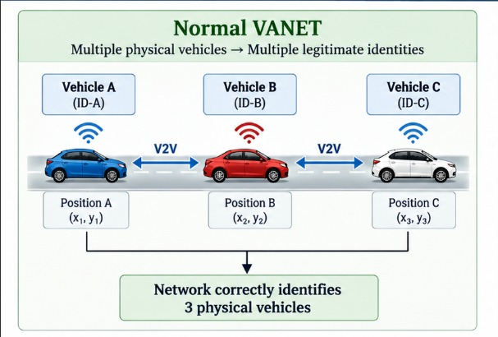
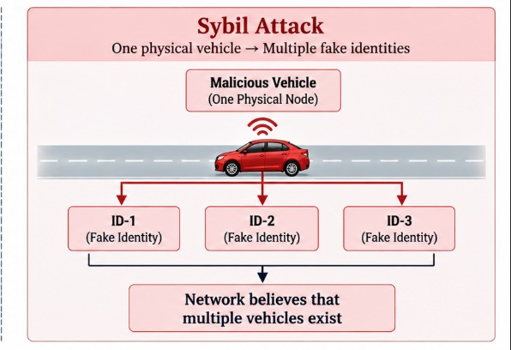
Continuation

Slide 8
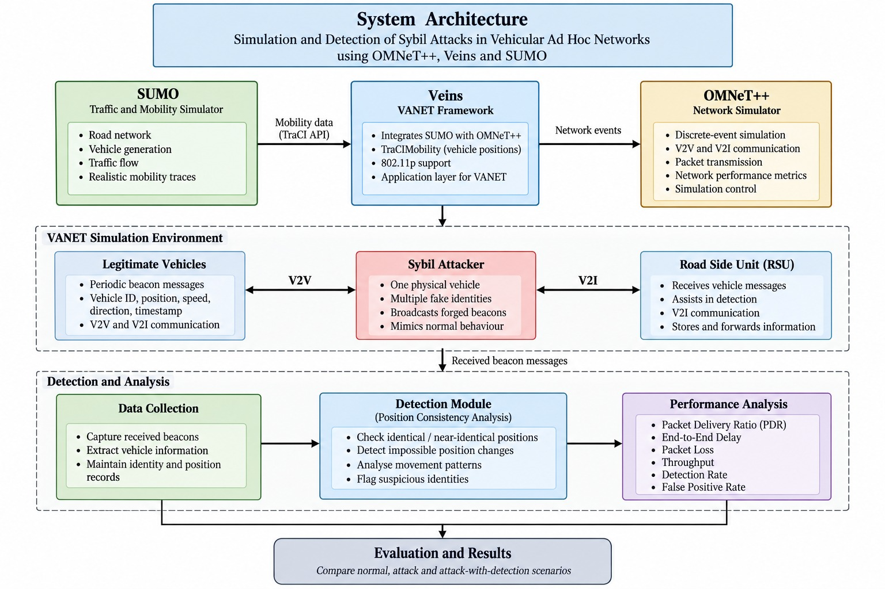
Block Diagram of simulation and detection of sybil attacks in vanet

Slide 9
Methodology
The methodology begins by creating a realistic road and traffic environment using SUMO. Multiple vehicles are then introduced and their mobility information is transferred to OMNeT++ through TraCI and Veins. Vehicles periodically exchange beacon messages containing their claimed identity, position, speed and timestamp. A normal baseline scenario is first simulated to measure network performance without an attack. Next, one vehicle is configured as a Sybil attacker that broadcasts messages using multiple fake identities. The receiving vehicles or RSU analyse the reported identities and their movement information using the proposed detection mechanism. Suspicious identities are identified based on position and movement inconsistencies, and the network performance is then compared across normal, attack and attack-with-detection scenarios.

Slide 10
Tools used
OMNeT++ – Discrete-event network simulation
Veins – VANET simulation framework
SUMO – Vehicle mobility and traffic simulation
TraCI – Communication interface between SUMO and OMNeT++
Python – Data extraction, processing, analysis, and graph generation

Slide 11
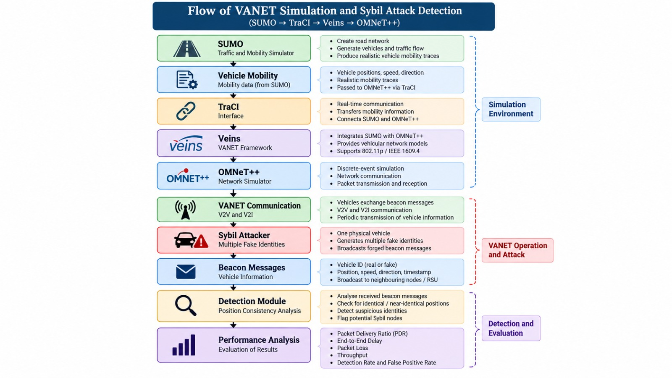
Flow chart

Slide 12
Existing methods
Several techniques have been proposed for detecting Sybil attacks in VANETs. Position-based methods compare the claimed positions of different identities and identify identities appearing at the same or physically impossible locations. RSSI-based methods use received signal strength to estimate whether multiple identities could originate from the same physical location. Trust-based methods assign trust values to vehicles based on their previous behaviour and communication history. Timestamp and mobility-based methods analyse the timing and movement patterns of reported vehicles. Although these approaches can be effective, their performance depends on factors such as positioning accuracy, communication conditions, attacker behaviour and computational requirements.

Slide 13
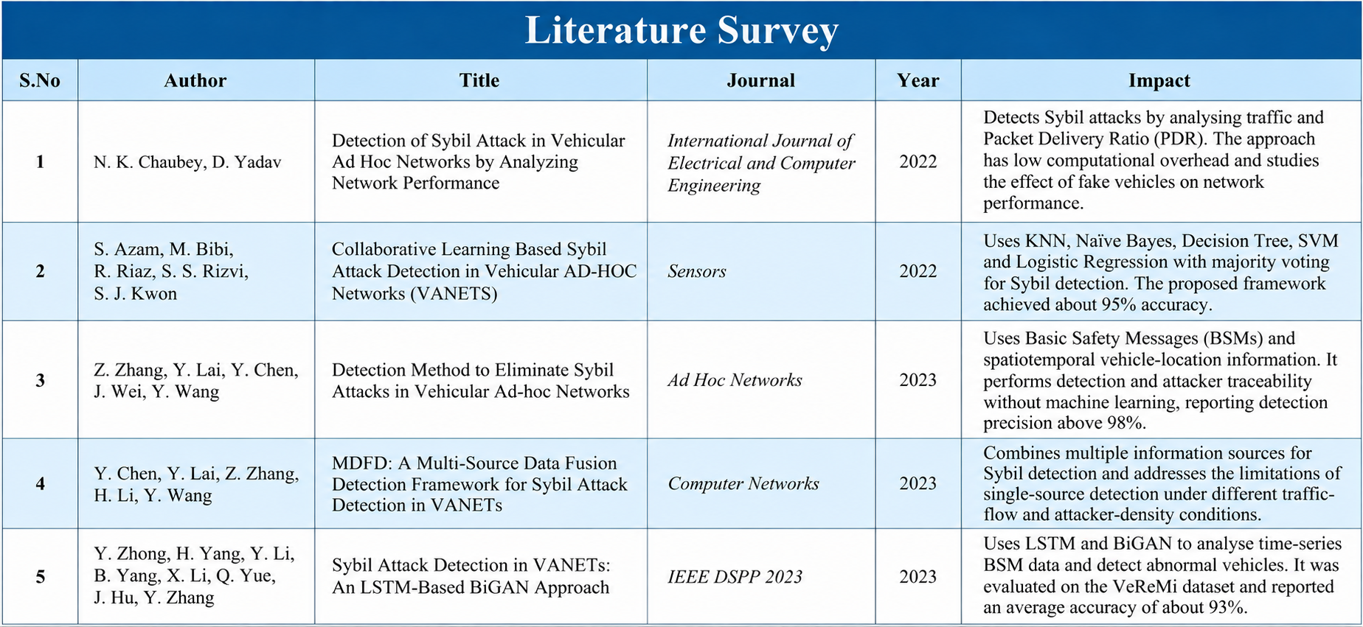
Literature survey

Slide 14
Proposed method
The proposed method is a position-consistency-based Sybil attack detection mechanism. Each receiving vehicle or RSU maintains information about the claimed identity, position and timestamp of received beacon messages. The system checks whether multiple identities appear at the same or nearly the same physical position at the same time. It also checks for physically impossible position changes and highly synchronized movement patterns between different identities. If the observed behaviour exceeds a predefined threshold, the corresponding identity is flagged as suspicious. This approach uses the physical movement of vehicles as additional evidence instead of relying only on the claimed identity.

Slide 15
Experimental scenarios
The proposed system will be evaluated using multiple controlled scenarios. The baseline scenario represents normal VANET communication without an attack. The attack scenario introduces a Sybil attacker without any detection mechanism to observe its impact on network performance. The attack with detection scenario enables the proposed detection mechanism to evaluate whether the attack can be identified and its impact reduced. Additional experiments will vary the number of fake identities, such as 1, 3 and 5 identities, and different vehicle densities will be considered to study system performance under different traffic conditions.

Slide 16
Realistics constraints
The project is simulation-based, so the simulated wireless communication environment may not completely represent real-world V2X communication. Detection accuracy can be affected by GPS or position accuracy, vehicle density, communication conditions and the selected detection thresholds. A sophisticated attacker may attempt to generate more realistic positions and movement patterns, making detection more difficult. Colluding attackers using multiple physical vehicles may also reduce the effectiveness of a simple position-consistency approach. Therefore, the proposed method is intended as a practical simulation-based detection mechanism rather than a complete solution to all VANET security threats

Slide 17
Conclusion
This project focuses on simulating and detecting Sybil attacks in Vehicular Ad Hoc Networks using OMNeT++, Veins and SUMO. The system creates a realistic moving-vehicle environment, establishes V2V and V2I communication, introduces a malicious vehicle using multiple fake identities and applies a position-consistency-based detection mechanism. The effectiveness of the proposed approach will be evaluated by comparing normal and attacked network conditions using parameters such as Packet Delivery Ratio, delay, packet loss, throughput, detection rate and false-positive rate.

Slide 18
Future scope
The project can be extended to detect other VANET security threats such as Denial-of-Service attacks, false-information attacks, black-hole attacks and GPS spoofing. More advanced detection techniques such as machine learning, trust-based detection and cooperative detection can also be investigated. Future work can include larger and more complex road networks, real-world traffic and V2X datasets, hardware-in-the-loop testing and integration with real automotive communication systems. The proposed system can also be extended toward safety applications such as cooperative collision warning, where reliable and trustworthy vehicle information is critical

